Slide 1
Multiplying fractions
In order to multiply fractions:
1. Change mixed numbers into improper fractions
2. Multiply the numerators
3. Multiply the denominators
NOTE: The denominators do not need to be the same
3. Simplify if needed
Remember the word “of”
Remember what are whole numbers out of.

Slide 2
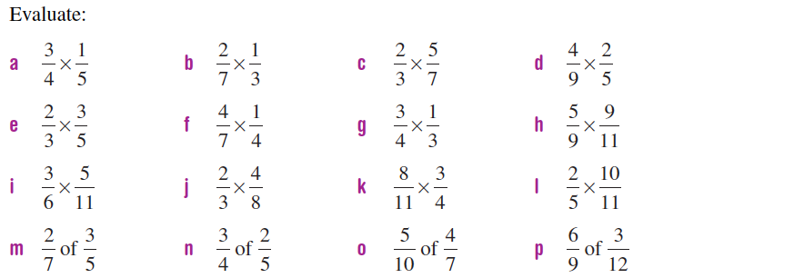

Slide 3
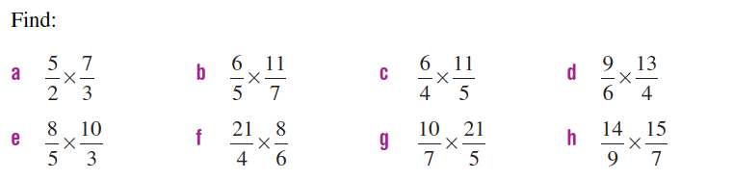

Slide 4
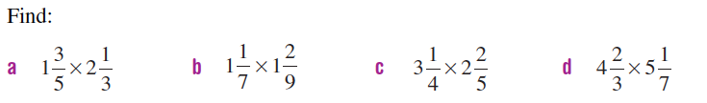

Slide 5
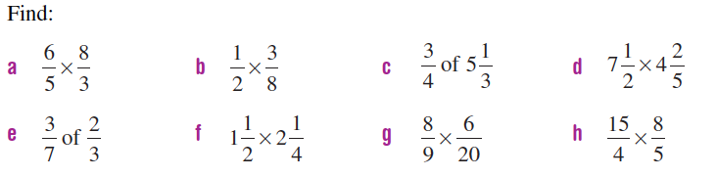

Slide 6
Dividing fractions
The reciprocal of a fraction is………
To divide fractions
Change mixed numbers to improper fractions (if needed)
Put whole numbers over 1 (if needed)
Find the reciprocal of the second fraction
Now multiply

Slide 7
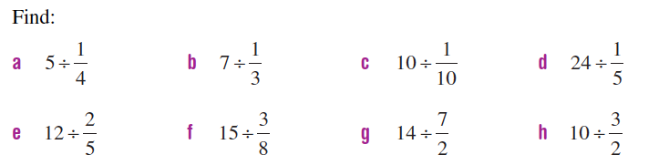

Slide 8
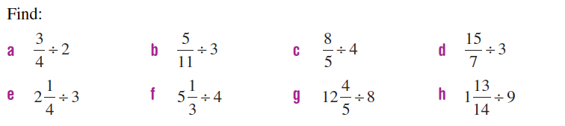

Slide 9
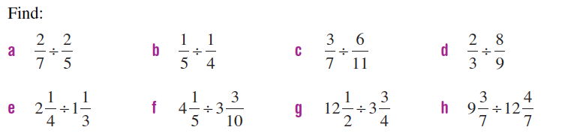

Slide 10
